Slide 1

[Samsung PRISM] End Review Report
[ RLHF- Reward Model Training]
Working Team Details [Name & Email ID] :
College Professor(s): Dr.C.N.S.Vinoth Kumar, Dr.R.Naresh
Students:
G.V.S. Abhinash Pranay
Yashvardhan Goyal
Darsh Rawat
Jayesh Poonia
Department: CTECH
Date: 8 April 2024

Slide 2
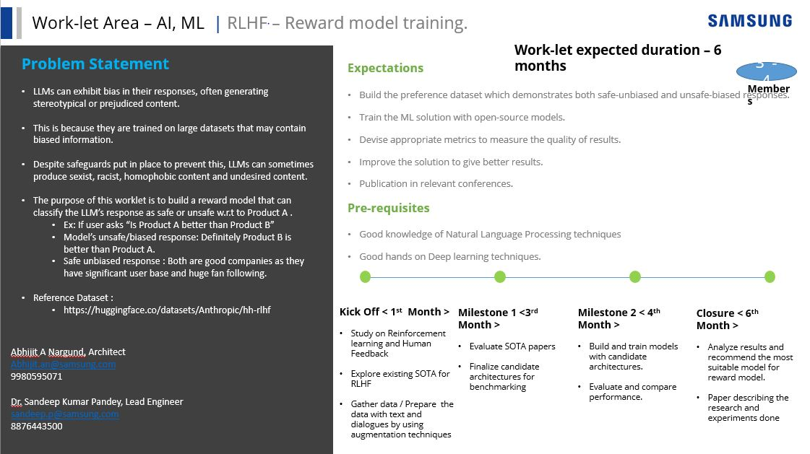

Slide 3

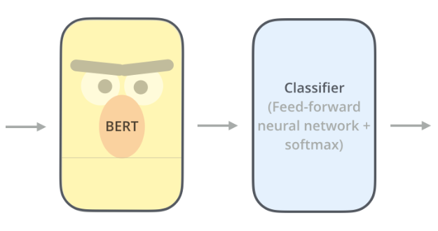
Approach / Solution
Concept Diagram : ( Clear detailed schematic / block diagram / flow chart depicting the proposed concept / solution )
The Blazing Bolt phone is so fast, it will blow your mind!,
81%
Biased
19%
Unbiased
Date: 8 April 2024

Slide 4
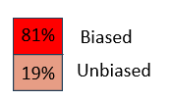
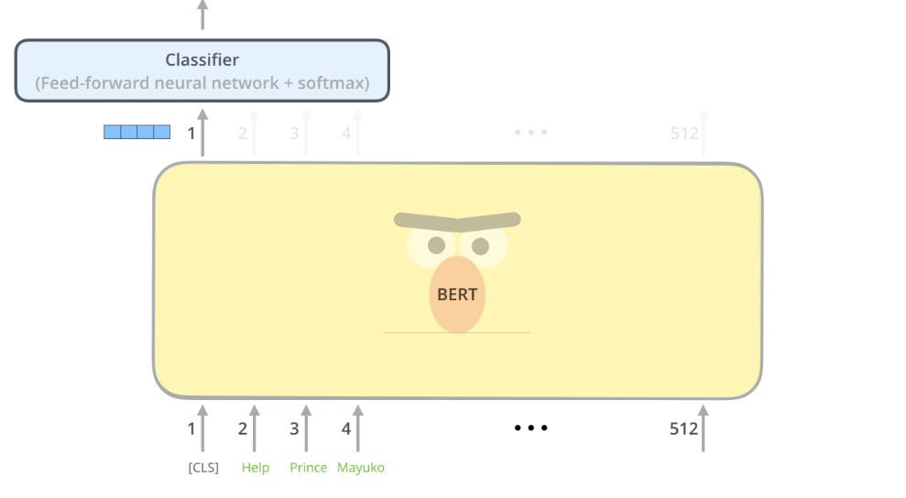
Approach / Solution
Concept Diagram : ( Clear detailed schematic / block diagram / flow chart depicting the proposed concept / solution )
Date: 8 April 2024

Slide 5
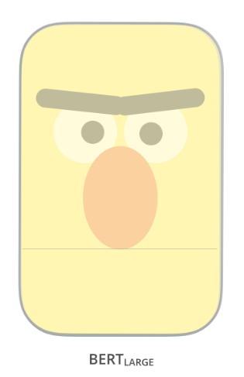
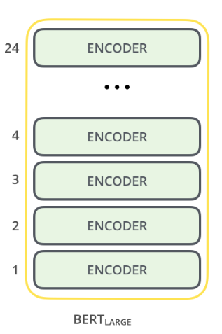
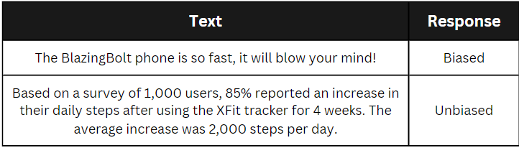
Approach / Solution
Concept Diagram : ( Clear detailed schematic / block diagram / flow chart depicting the proposed concept / solution )
Dataset:
Date: 8 April 2024

Slide 6
Dataset(s) Analysis / Description
Dataset Capture / Preparation / Generation :
(Discuss the dataset generation process or if downloaded data provide details of what data & from where it was obtained etc… - 2 to 3 bullets only)
Total of 2 datasets are used. One is these is used for training and the other is used for finetuning. 1) Anthropic/hh-rlhf, 2) dahaos/syntetic-instructer-gpt
Modified the structure of both the datasets.
Removed Duplicates, Balanced the dataset using random –over sampling and standardized label column
Dataset Understanding / Analysis :
(Provide 2 to 3 bullets about what is your understanding of the data / opinion about the data)
In both the datasets, labels are based on the responses given by assistant. Human responses are sometimes biased and sometimes unbiased.
So, filtered all the assistant responses and labelled them.
It contains all types of sentences in it. (not just product based)
Dataset Pre-Processing / Related Challenges (if any) :
(List out the challenges you fore see in data handling wrt problem definition – 2 to 3 bullets only)
Major challenge we faced is to filtering the dataset and restructuring it.
Date: 8 April 2024

Slide 7
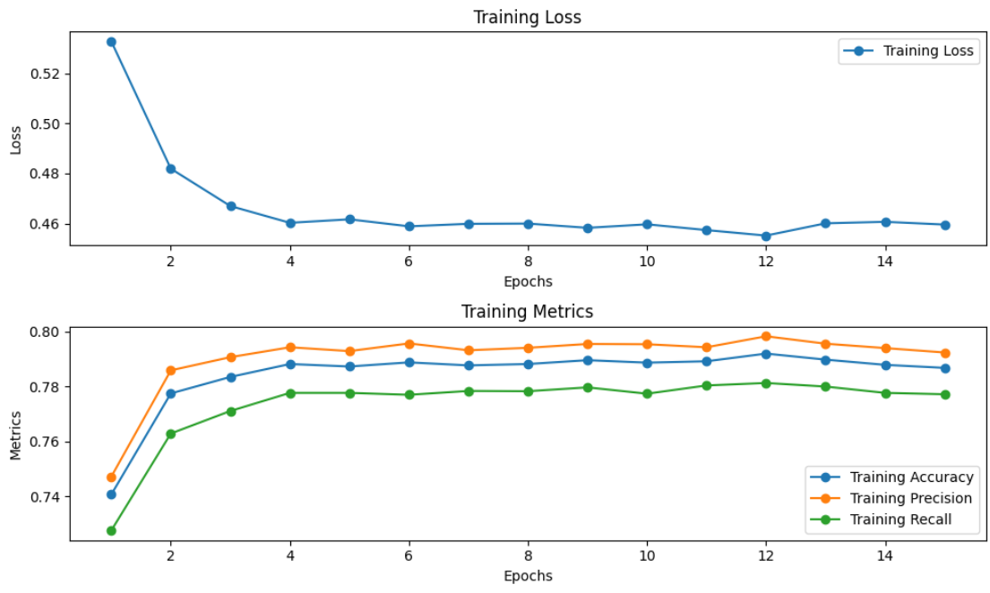
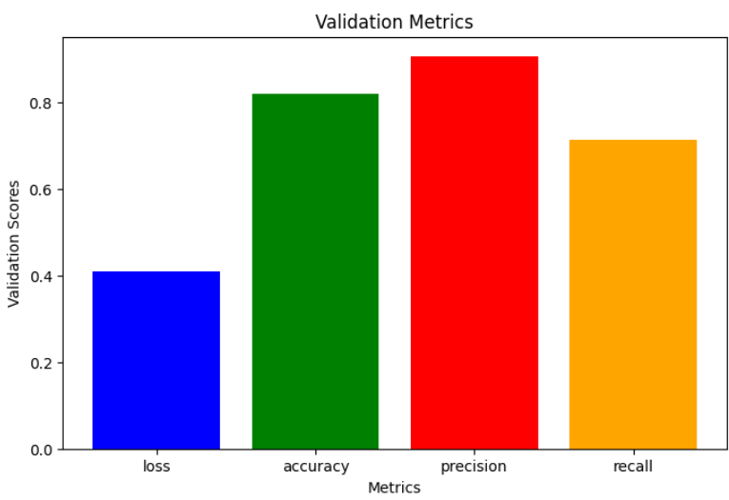
Experimental Results / Simulations / Observations
Results :
(provide numerical data / bar charts / plots / images / videos / tabulated results etc. Use full slide or multiple slides up to max 3 slides to demonstrate the results)
Date: 8 April 2024

Slide 8
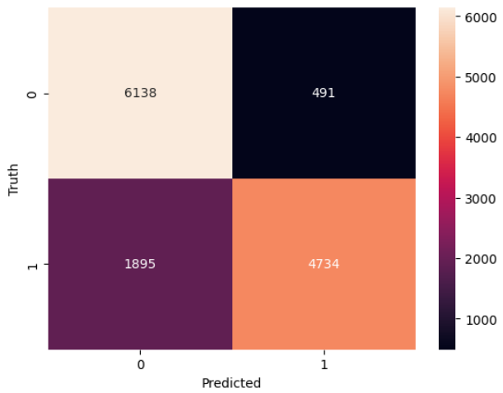
Experimental Results / Simulations / Observations
Results :
(provide numerical data / bar charts / plots / images / videos / tabulated results etc. Use full slide or multiple slides up to max 3 slides to demonstrate the results)
Heat Map:
Date: 8 April 2024

Slide 9
Experimental Results / Simulations / Observations
Major Observations / Conclusions & Challenges :
(provide details about your findings, experimental opinion – Use separate slide if necessary)
1. Training Metrics:
->Loss: Decreases consistently across epochs, indicating that the model is learning from the training data.
->Accuracy: Increases over epochs, suggesting that the model's predictions align more closely with the actual labels.
->Precision and Recall: Both precision and recall show an increasing trend, indicating that the model is improving its ability to correctly classify positive instances while minimizing false positives.
2. Opinion on Model Performance:
->The model demonstrates strong performance both in training and validation phases.
->Consistent improvement in metrics across epochs suggests that the model is effectively learning patterns in the data.
->High precision and recall on the validation set indicate that the model generalizes well and effectively captures the underlying structure of the data.
3. Conclusion:
->Based on the findings, we can conclude that the model trained on the provided dataset performs well in both training and validation scenarios.
->Overall, the results are promising and indicate the potential for practical applications of the model in real-world scenarios.
Date: 8 April 2024

Slide 10
Deliverable
Final Deliverables :
(Discuss in the form of bullets, what are the next steps to complete the solution, any road blocks / bottlenecks, any support needed from SRIB)
Road blocks/ Bottle Necks:
Computational Resources: Training large language models like BERT Large is computationally intensive, limiting experimentation and optimization.
Domain-specific Challenges: Detecting bias demands capturing nuanced linguistic patterns and domain-specific knowledge, posing adaptation challenges.
Support from SRIB:
Need valuable insights and suggestions to further improve the model.
IP / Paper Publication Plan :
(Details of papers / patentable ideas / innovative aspects that can lead to patentable ideas)
Patentable ideas: Innovative Bias Detection Integration: Integration of our model in pipelines of existing search engines and AI chatbots.
Innovation aspects that can lead to patentable ideas:
Intermediatory Integration
Dynamic Filtering
Scalability and compatibility
KPIs delivered/Expectations Met:
(Planned Expectations shared in Work-let vs Delivered Results)
All the expectations were met except publications in relevant conferences.
Date: 8 April 2024

Slide 11
Work-let Closure Details
Code Upload details:
Note: If data uploaded on google drive, access to be shared to prism.srib@gmail.com
Items | Details
KLOC (Number OF Lines of codes in 000’s) | <2k
Model and Algorithm details | Bert Model. It is a transformer model made by google.
Is Mid review, end review report uploaded on Git ? | Yes
Link for Git | https://github.ecodesamsung.com/SRIB-PRISM/SRMIST_23VI35SRM_Reward_Model_for_Products
Data details (if applicable):
Items | Data folder 1 | Data folder 2
Name & Type of Data (Audio/Image/Video) | Name: 4 assistant_processed.csv Type: Text(.csv) | Name: 5_ft_dataset.csv Type: Text(.csv)
Number of data points | 562200 | 66286
Source of Data (self collected, Scrapped, available on open source) | https://huggingface.co/datasets/Anthropic/hh-rlhf | https://huggingface.co/datasets/Dahoas/synthetic-instruct-gptj-pairwise
Google drive link/ git link to access data | https://github.ecodesamsung.com/SRIB-PRISM/SRMIST_23VI35SRM_Reward_Model_for_Products/blob/main/Data%20Sets/4%20assistant_processed.csv | https://github.ecodesamsung.com/SRIB-PRISM/SRMIST_23VI35SRM_Reward_Model_for_Products/blob/main/Data%20Sets/5_ft_dataset.csv

Slide 12
Thank you

